Slide 1
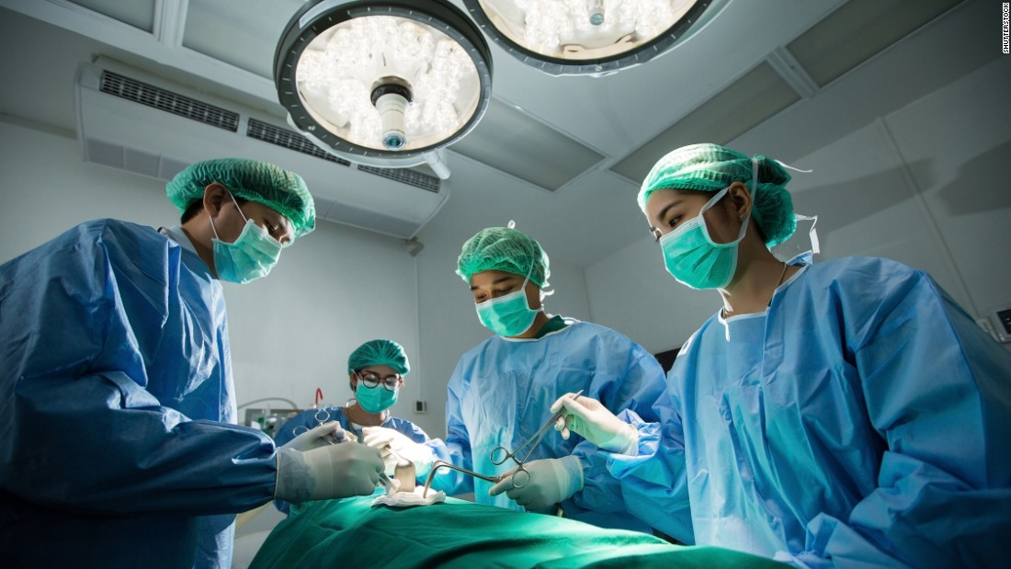
Taunton MRCS Part B Revision Course
Saturday 6th / Sunday 7th April 2019
Musgrove Park Academy,
Parkfield Drive, Taunton, TA1 5DA
Convenors:
Mr Edward Smyth
Dr Nahida Bashir
Viva Sessions
Small Group Teaching
Personalised Feedback
Focus on Common Exam Themes
Mock OSCE
Course Fee: £200 (£150 for Severn/Peninsula trainees)
If interested please email: admin@emrcs.com
Deadline for applications: 22nd March 2018 (Places limited)

